Slide 1

INTRODUCTION
Zobo Robo is a creative animation project focused on rebranding traditional zobo drink
The project presents zobo as a modern, canned beverage
It combines cultural identity with contemporary design and animation techniques

Slide 2
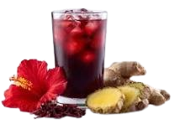
Problem Statement
Traditional zobo is often perceived as informal and unhygienic
Limited branding reduces it’s appeal to younger and urban consumers
There is a lack of modern visual representation of local beverages

Slide 3
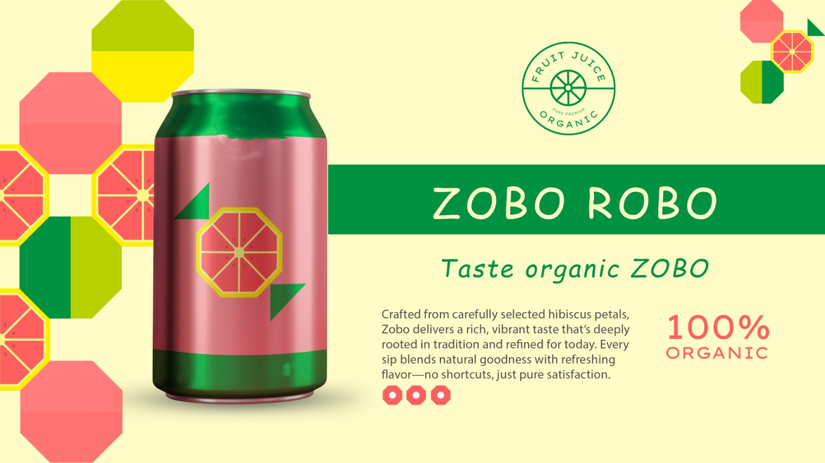
Aim & Objectives
Aim: To create an animated concept that presents zobo as a modern canned drink
To design a visually appealing can and character concept
To promote local beverages through animation
To improve consumer perception of zobo
To improve the hygien of zobo drinks

Slide 4
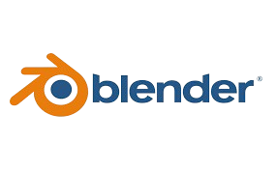
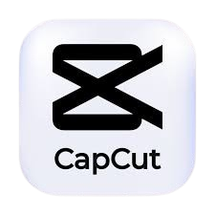

Methodology & Materials
Learning process for Animation Process
Character and product design
3D animation process
Materials: Blender 4.5, PhotoShop, Capcut Pro
Voice Over and Editing

Slide 5
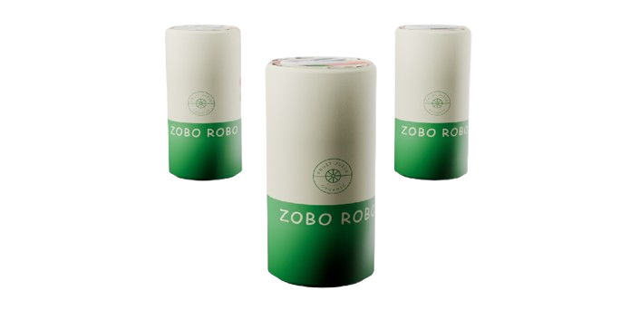
Results & Challenges
Successful creation of a modern zobo can concept
Improved visual appeal through animation
Major challenges included:
Communication during animation process
Compatability of animation software
Idea Generation: Integrating local ideas with modern concepts.

Slide 6
Future Work
Expertise in Animation Design
We are looking to work towards developing an animated advertisement for the University itself
Enhance this particular work and monetize the product as well as developing multiple flavors for it.
Explore collaboration with beverages brands and other industries.

